Slide 1
Professional JavaScript for
Web Development
Chapter-4 :Variables, Scope, and Memory
PRESENTED BY:
DAW SAW THANDAR SHWE
LECTURER
ITSM DEPARTMENT
UNIVERSITY OF COMPUTER STUDIES (SITTWAY)
Information Technology Supporting and Maintenance

Slide 2
Outlines
Primitive and Reference Values
Execution Context and Scope
Garbage collection
Information Technology Supporting and Maintenance

Slide 3
Primitive and Reference Values
ECMAScript variables may contain two different types of data:
  primitive values: simple atomic pieces of data
    Undifined
    Null
    Boolean
    Number
    String
  reference values: objects that may be made up of multiple values
eg1:
var name=“Nicholas”;
name.age=27;
alert(name.age); //undefined
eg2:
var person=new Object();
person.name=“Nicholas”;
alert(person.name); //”Nicholas
Information Technology Supporting and Maintenance

Slide 4
Execution Context and Scope
two primary types of execution contexts:
  global context
  function context
function outer() {
var counter = 20;
return function inner() {
counter++;
alert("Counter ", counter);
}
}
var func = outer();
func();
func();
outer execution context { scopeChain: [global execution Context] variable: { counter; } this: ... } === === === === === inner execution context { scopeChain: [outer execution Context] variable: {} this: ... }

Slide 5
Execution Context and Scope Example:
Eg1:
var color=“blue”;
function changeColor(){
if (color==“blue”){
color=“red”;
}else{
color=“blue”;
}
}
changeColor();
Eg2:
var color=“blue”;
function changeColor(){
var anotherColor=“red”;
function swapColors(){
var tempColor=anotherColor;
anotherColor=color;
color=tempColor;
}
swapColors();
}
changeColor();

Slide 6
Variable Declaration
Local variable
function add(num1,num2){
var sum=num1+num2;
return sum;
}
var result=add(10,20);//30
alert(sum);//error
Global variable
function add(num1,num2){
sum=num1+num2;
return sum;
}
var result=add(10,20);//30
alert(sum);//30

Slide 7
Garbage collection
JavaScript is a garbage-collection language, meaning that the execution environment is responsible for managing the memory required during code execution.
The predominant garbage-collection algorithm is called mark-and-sweep.
A second, less-popular type of garbage collection is reference counting.
In a garbage-collected programming environment, developers typically don’t have to worry about memory management
Information Technology Supporting and Maintenance

Slide 8
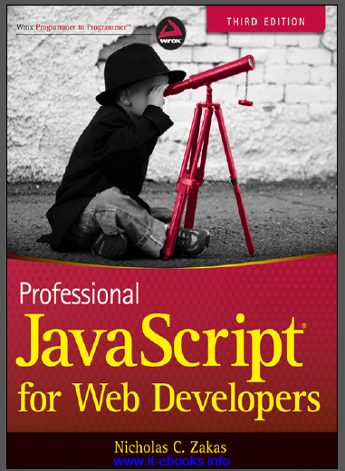
References
“PROFESSIONAL JavaScript for web Developers”
Third Edition
Zichalos C.Zakas
Nicholas, “Professional JavaScript for Web Development”
Colleen van Lent Ph.D, “INTERACTIVITY WITH JAVASCRIPT”

Slide 9
Thank You
1

